Slide 1
Why Us?
Relevant Domain Experience
Founders have experience taking physical products from idea to market,
rapid prototyping mobile-first applications,
building scalable inventory-management and logistics networks.
Untapped Opportunity
Competitors are focused on existing solutions and ad-networks
No one is focusing on publisher-first, user-friendly revenue models
Competitive Advantage
Long-play with high rewards. Existing competitors are too entrenched in existing high-yield advertising models to break into new opportunities.
Mobile-first. Competitors were built for eCommerce, it's difficult for them to break into mCommerce.
First mover advantage. Developer resources are expensive & consumer consistency is important; Apps will be resistive to moving to new mCommerce solution.
High barrier to entry. Revenue model only works efficiently at scale. Requires key partnerships with retailers and wholesalers, and generation of a logistics network.

Slide 2
Tech Stack
Clutch - In-App Stores: Demo
Ionic / Angular
Node
Heroku
Trie - User Portals: Demo
Foundation / Saas
React
Heroku
API
Python / Flask
jsonapi
Integrations
Stripe
EasyPost
Shipwire

Slide 3
Competition: Shopify
Acquisition vs. Competition: With 3 acquisitions, Shopify would rather acquire innovation than develop it in house.
eCommerce Focused: Huge opportunity for Shopify to grow in eCommerce, small incentive to drastically explore new avenues.
Targeted at Retailers: Shopify targets retailers and businesses not Apps. Tote provides mCommerce solutions for affiliate apps.
Big Company: As a publicly traded company, Shopify has to meet revenue goals and is hard pressed to innovate in untested waters.

Slide 4
“We knew we could do what most people aim to do every day: avoid ads.”
— Jan Koum, WhatsApp

Slide 5
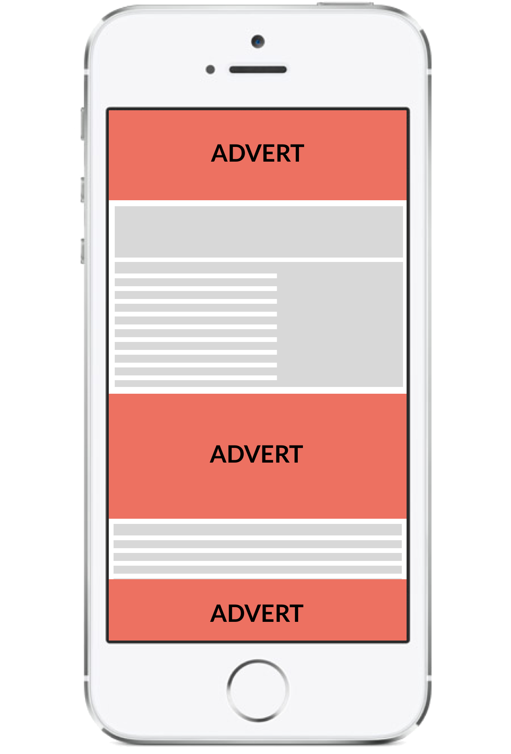
Because mobile ads detract from the user experience
Apps forgo ad revenue to focus on user growth...
AD
AD
AD

Slide 6
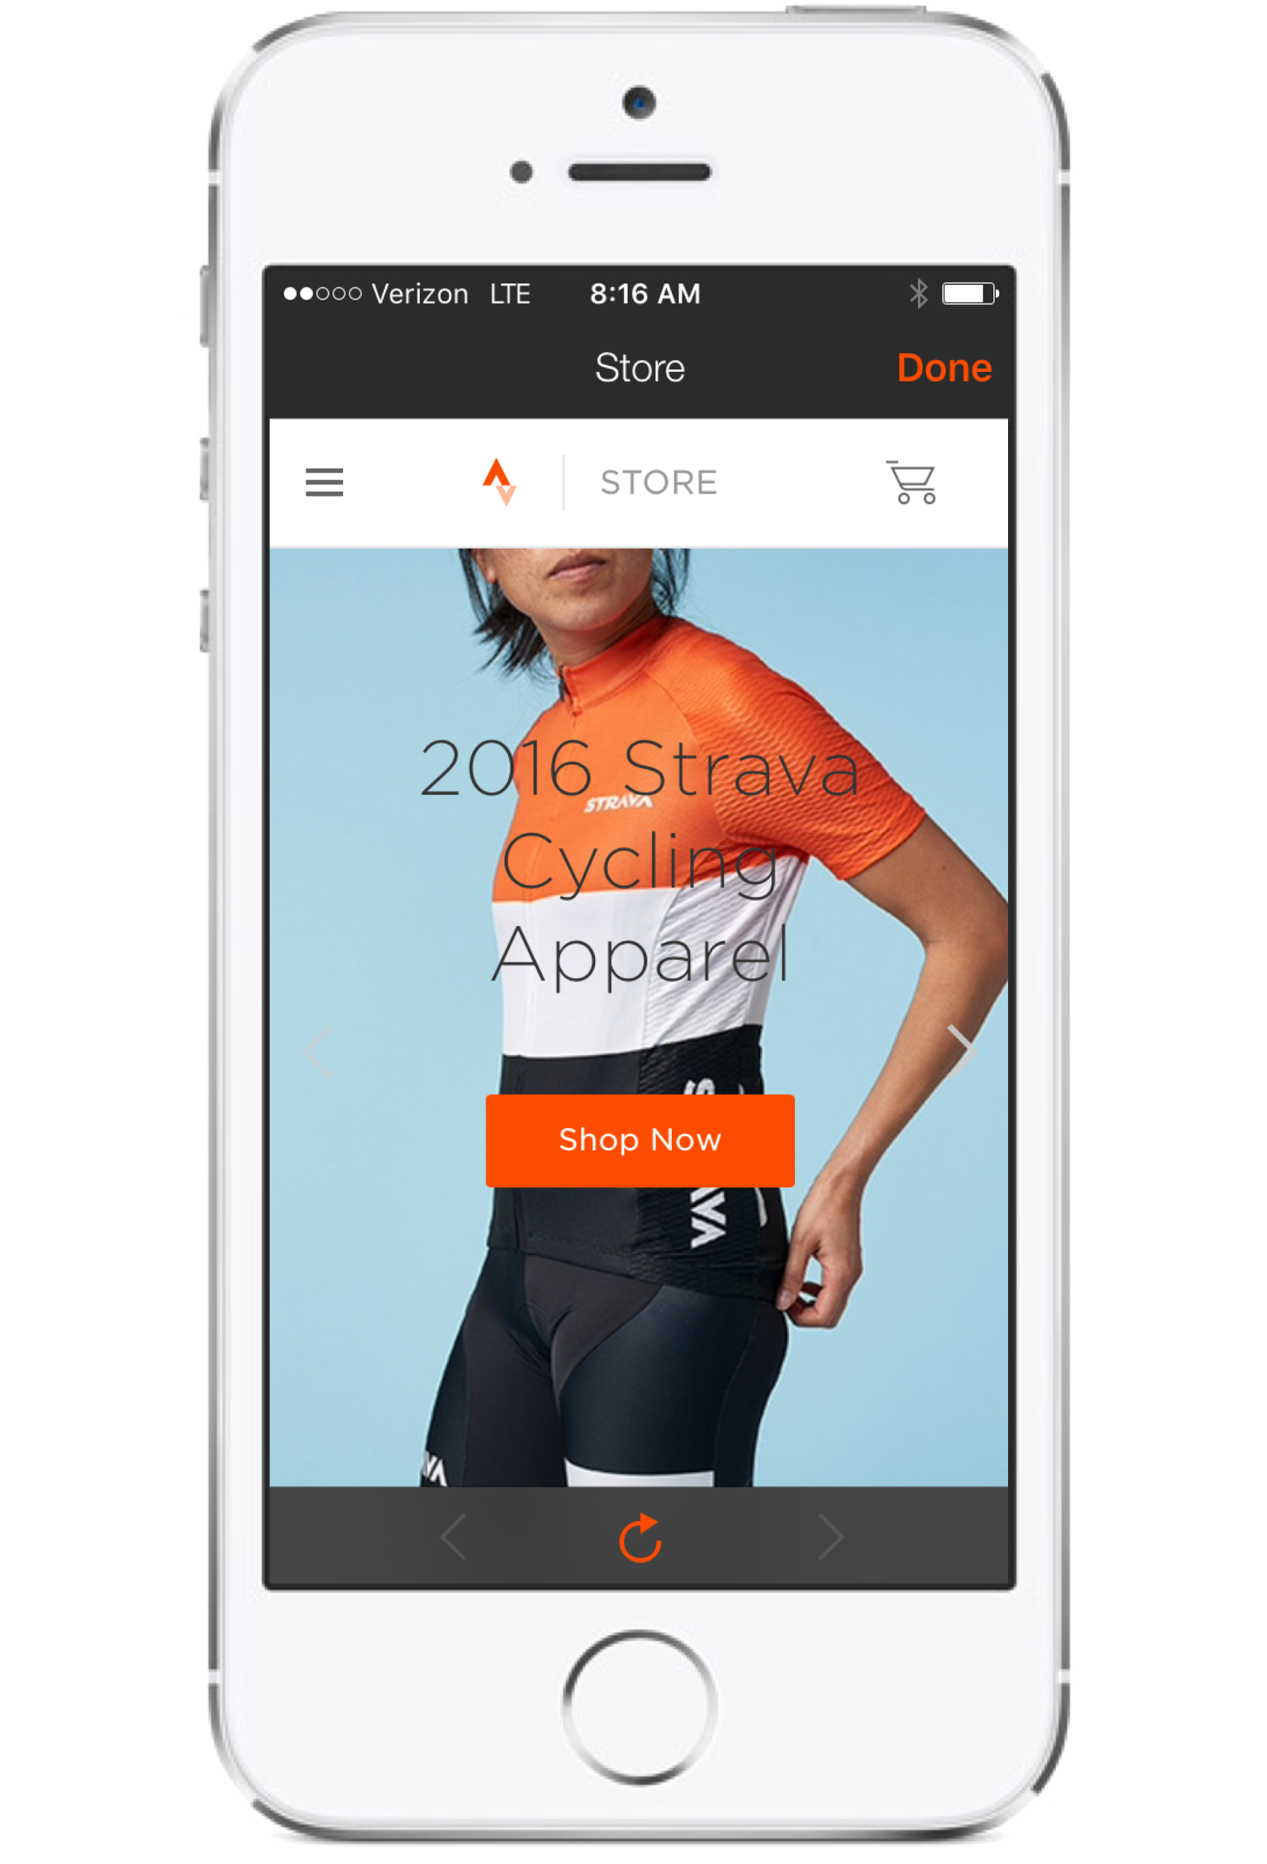
Some apps sell products directly, but this requires significant overhead.

